Slide 1
Weighted Linde-Buzo-Gray Stippling
Marc Spicker University of Konstanz, Germany

Slide 2
What it‘s all about...

Slide 3
Lloyd Relaxation
Target Density Distribution
cell too small
cell too large

Slide 4
Problems
Converges very slowly, no clear stop criterion.
Converges into hexagonal subsets
Results highly depend on initialization.
Number of points
Initial distribution
State-of-the-art algorithms: Complex, time-consuming, limited or unintuitive controls.

Slide 5
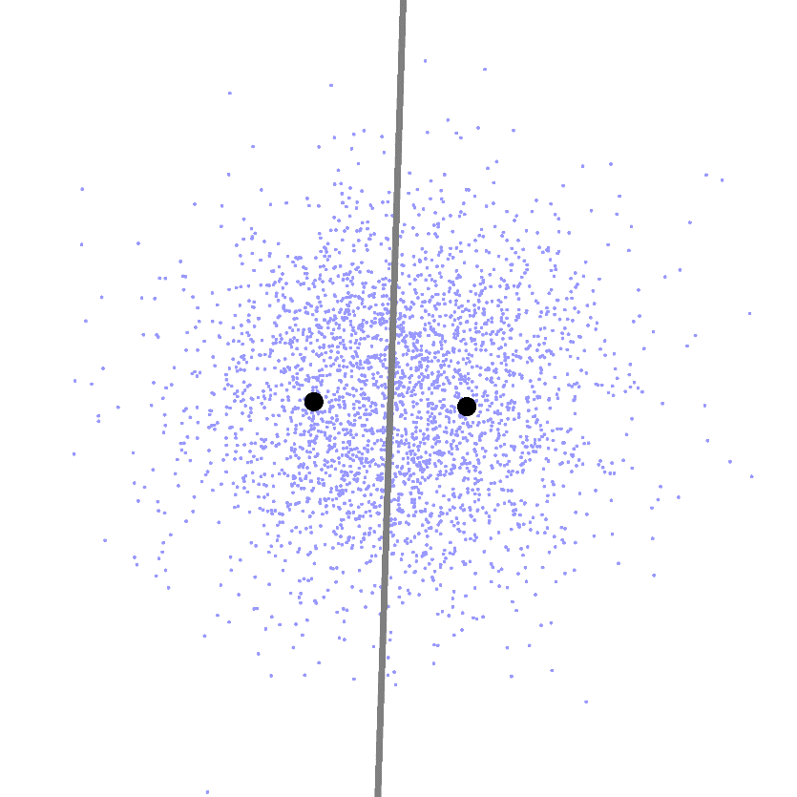
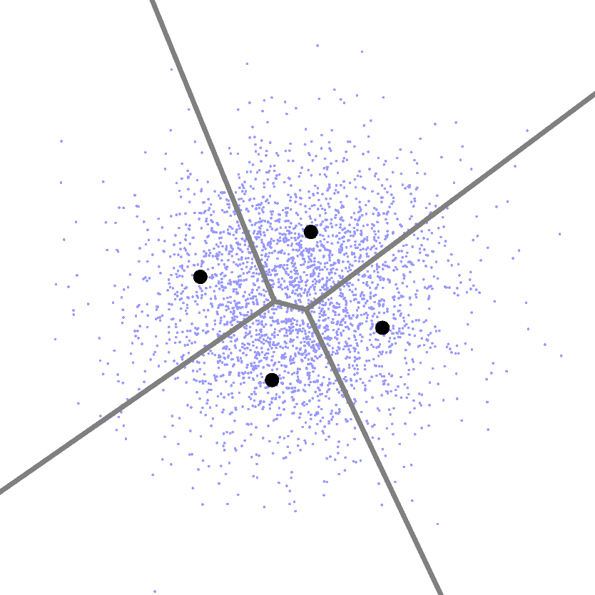
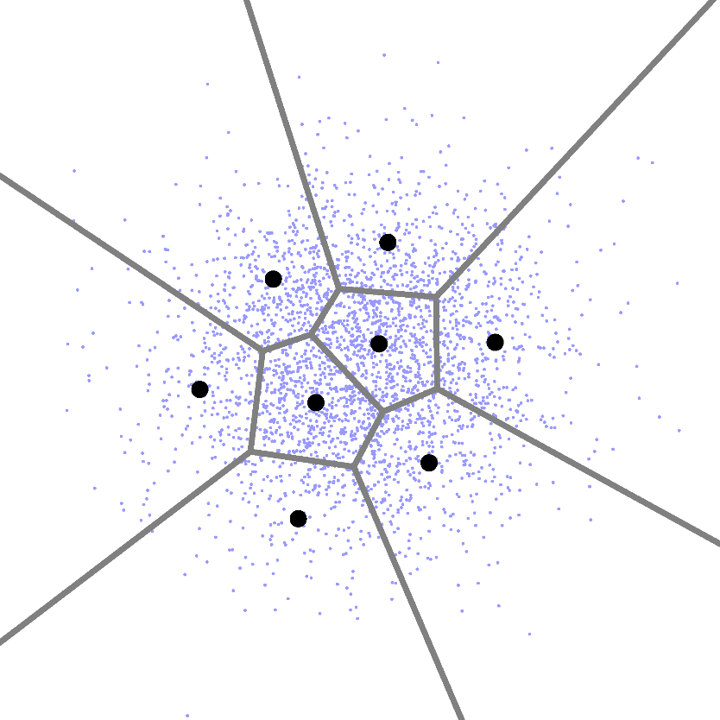
Linde-Buzo-Gray Algorithm
Algorithm after 1, 2, and 3 splitting steps on a training dataset.

Slide 6
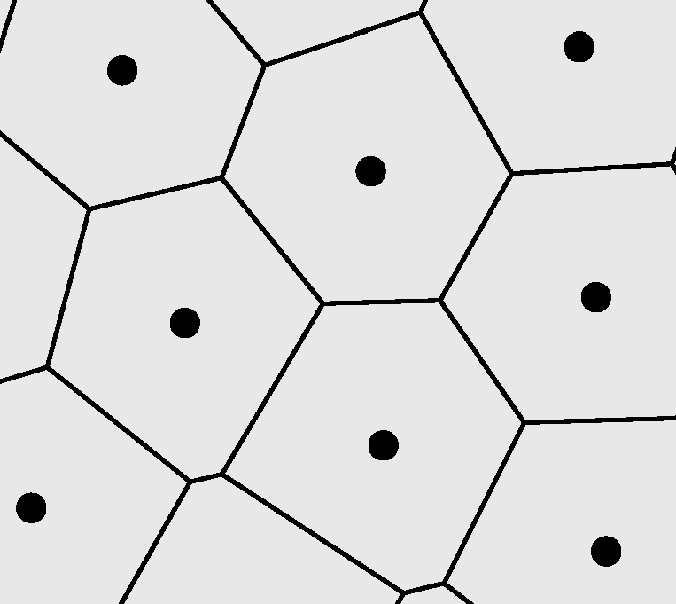
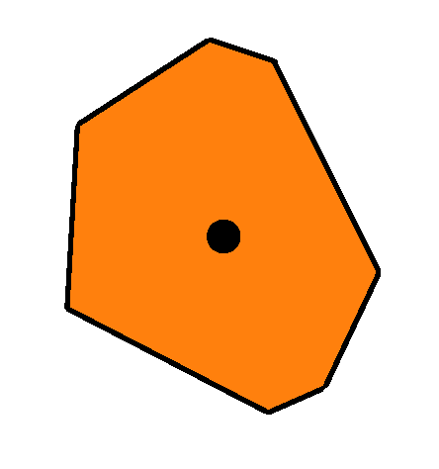
Our Algorithm
Split
Calculate
Integrate
Too large
1 : 2
Point Set
Voronoi Diagram
Voronoi Cells
Acceptable
Retain
1 : 1
Too small
Merge
1 : 0

Slide 7
Closer Look: Splitting and Merging
Contained Density $d=\int_{A}{p\left(x\right) dA}$
Centroid
Area of the generator $c= πr^{2}$
$>1$ → Split
$>1+α$ → Split
$$\frac{d}{c}$$
$1−α≤x≤1+α$ → Retain
$=1$ → Retain
$<1$ → Merge
$<1−α$ → Merge

Slide 8
Closer Look: Cell Splitting
Inscribing Circle $r$
Centroid
Cell Orientation $\vec{d}$
$\frac{1}{2}$ r
Split Seeds $S$:
$\frac{1}{2}$ r
$$S_{1,2}=c ±\frac{1}{2}∗r∗\vec{d}$$
r

Slide 9
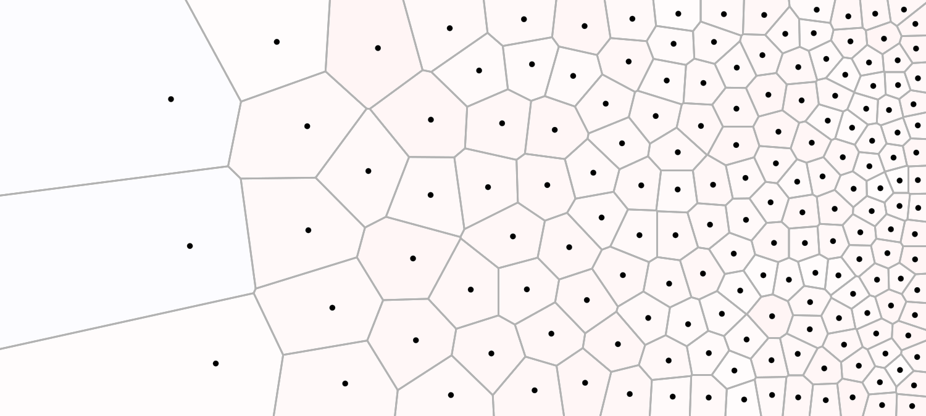
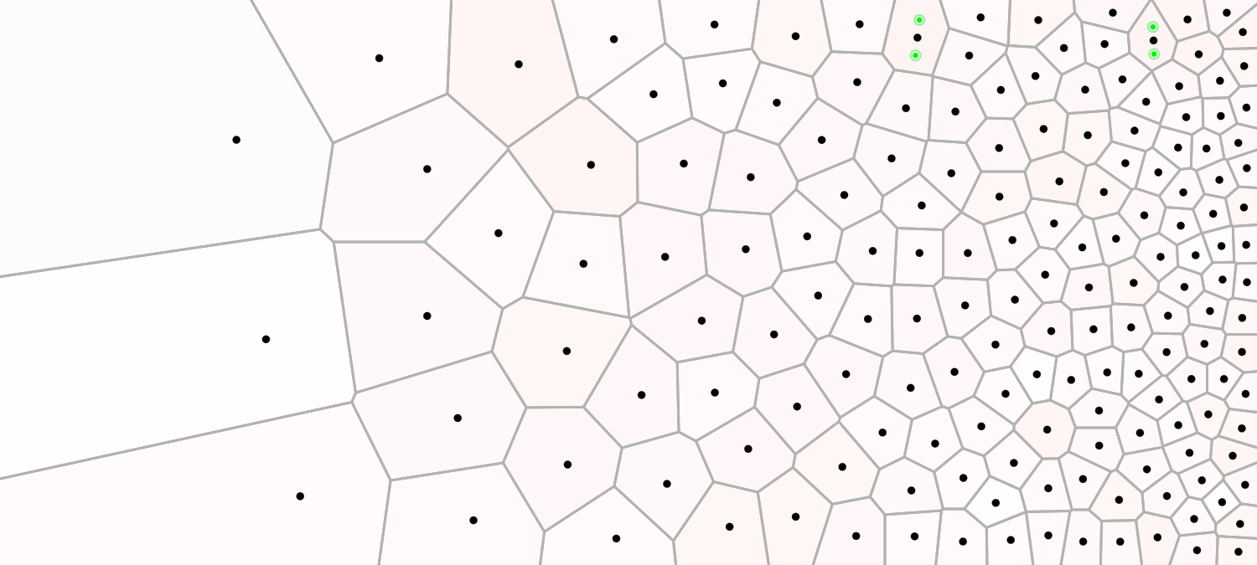
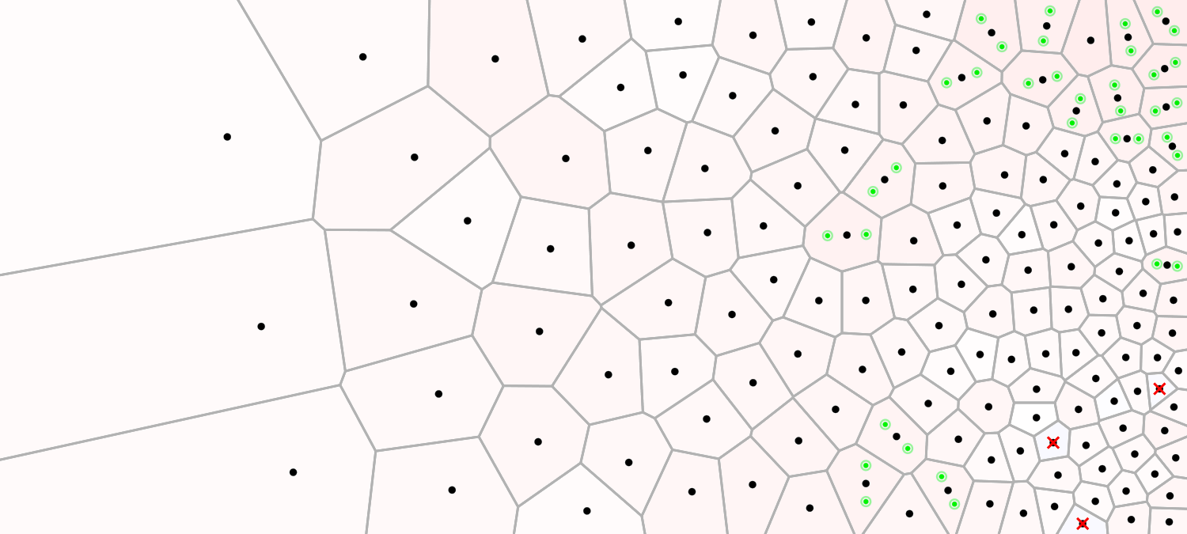
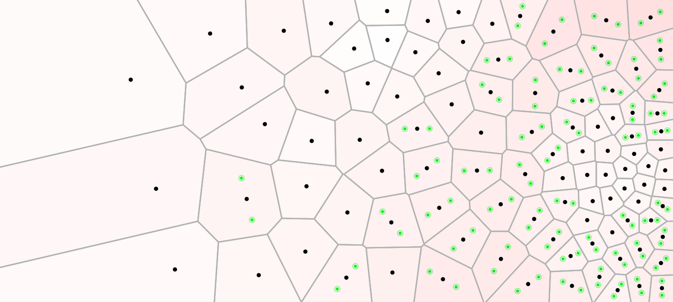
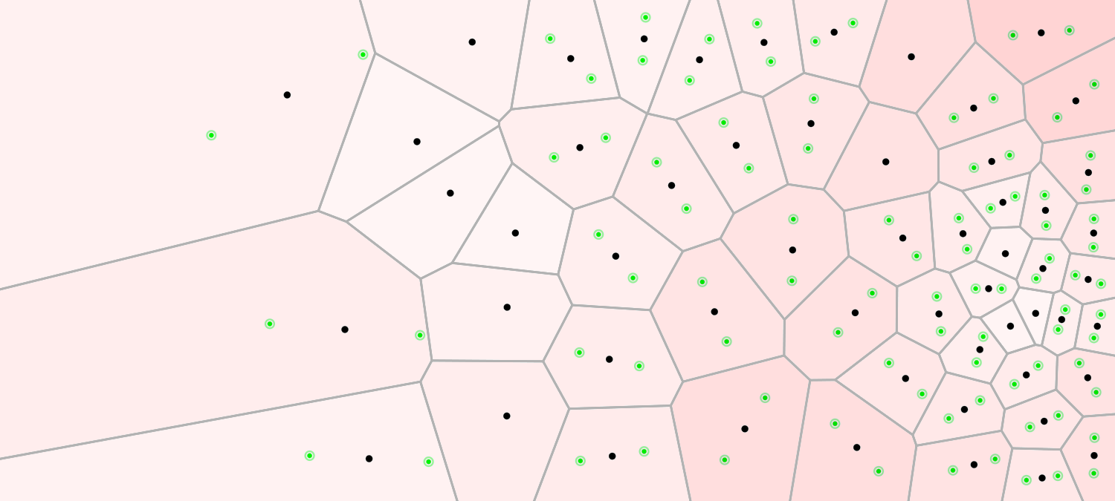
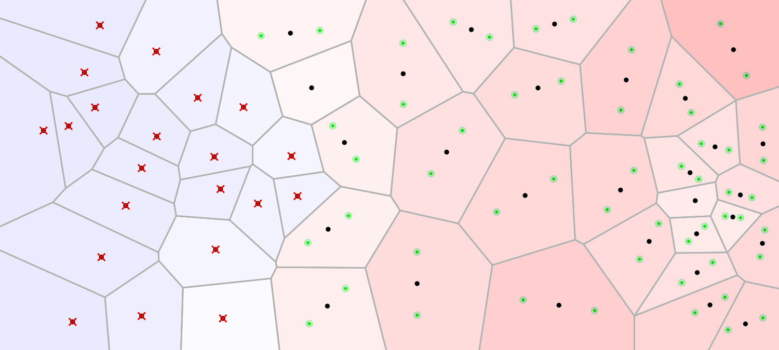
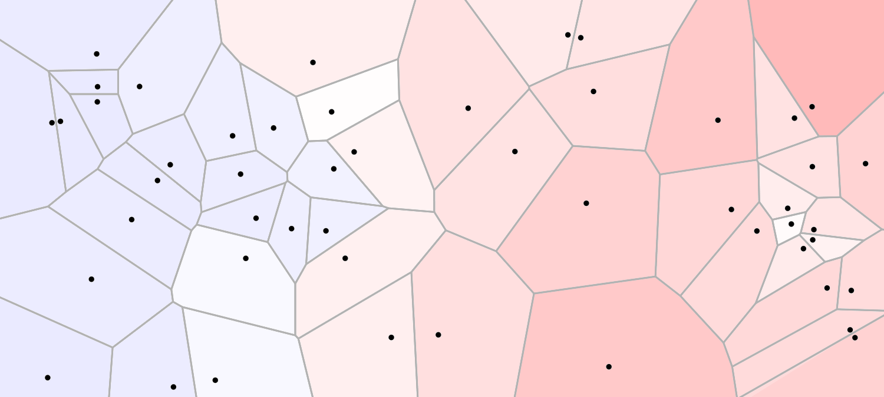
Iteration 6
Iteration 4
Iteration 5
Iteration 3
Iteration 2
Iteration 1
Initial Point Distribution
Target Density Distribution
cell too small
cell too large

Slide 10
16 iterations, approx. 31500 points

Slide 11
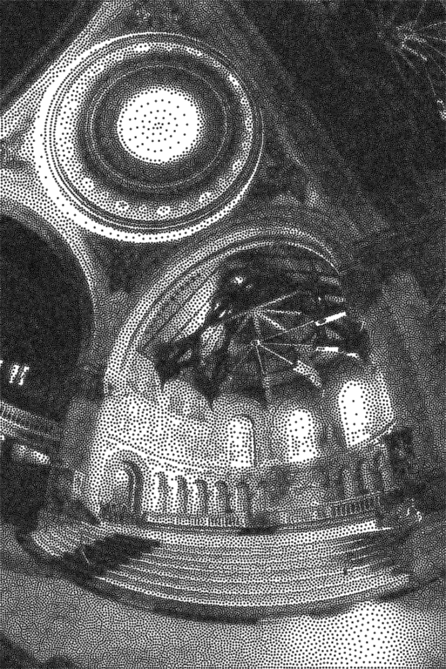
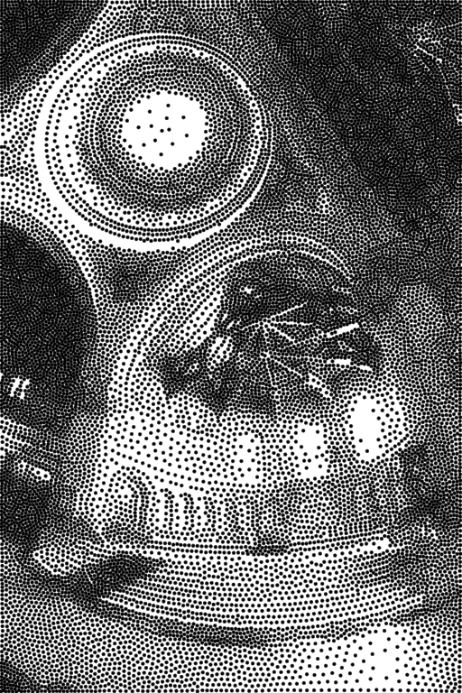
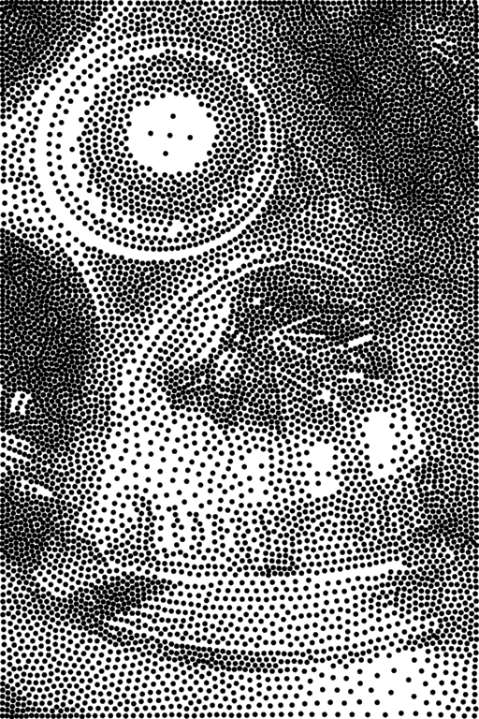
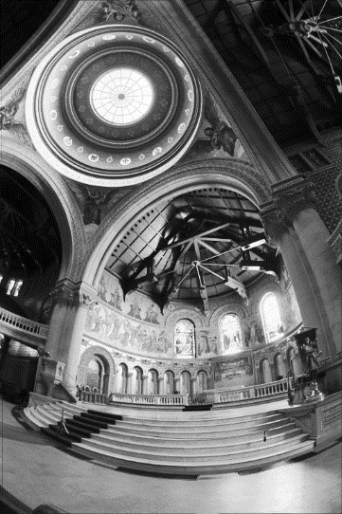
Global Point Size
Input
2x diameter
2x diameter
71.7k points
17.7k points
7.8k points

Slide 12
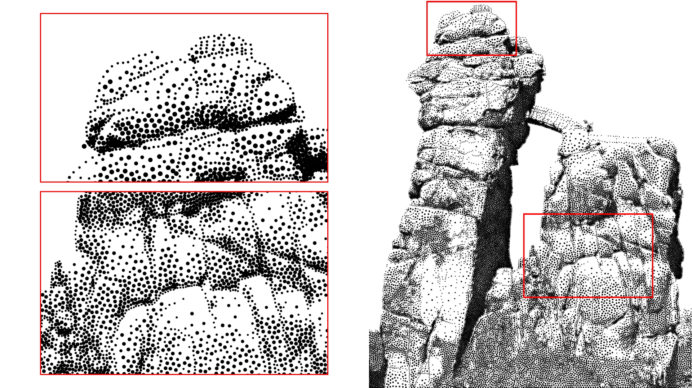
Local Point Size

Slide 13
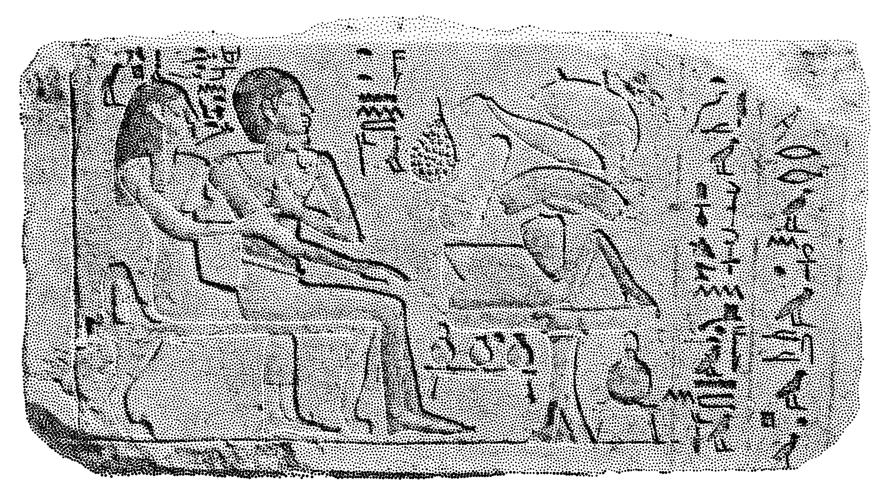
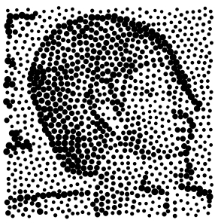
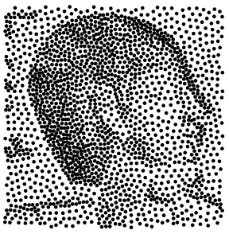
Variable Point Size
Constant Point Size

Slide 15
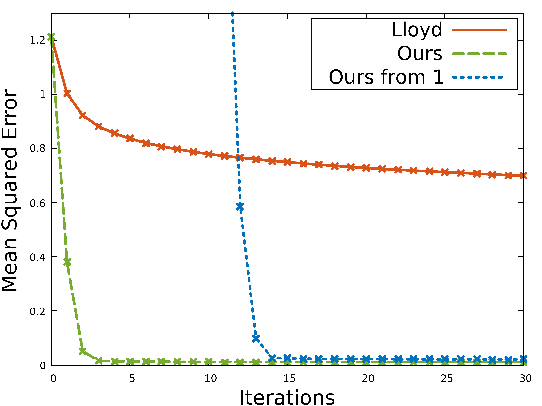
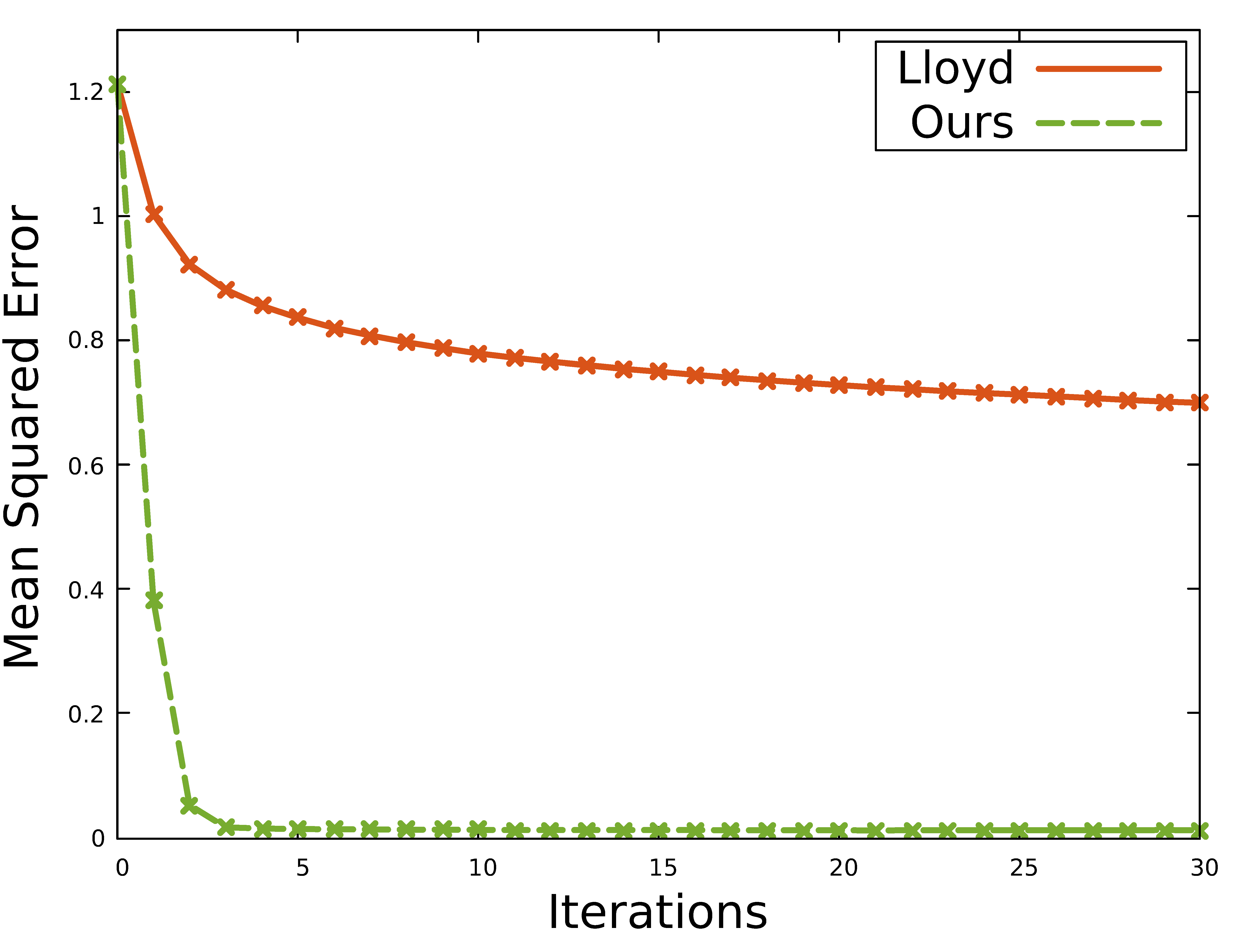
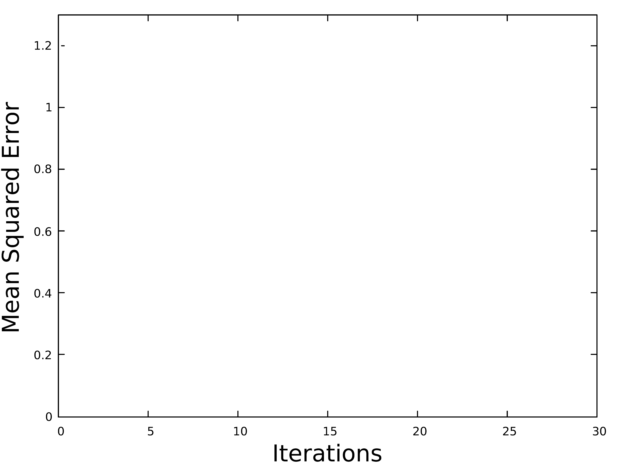
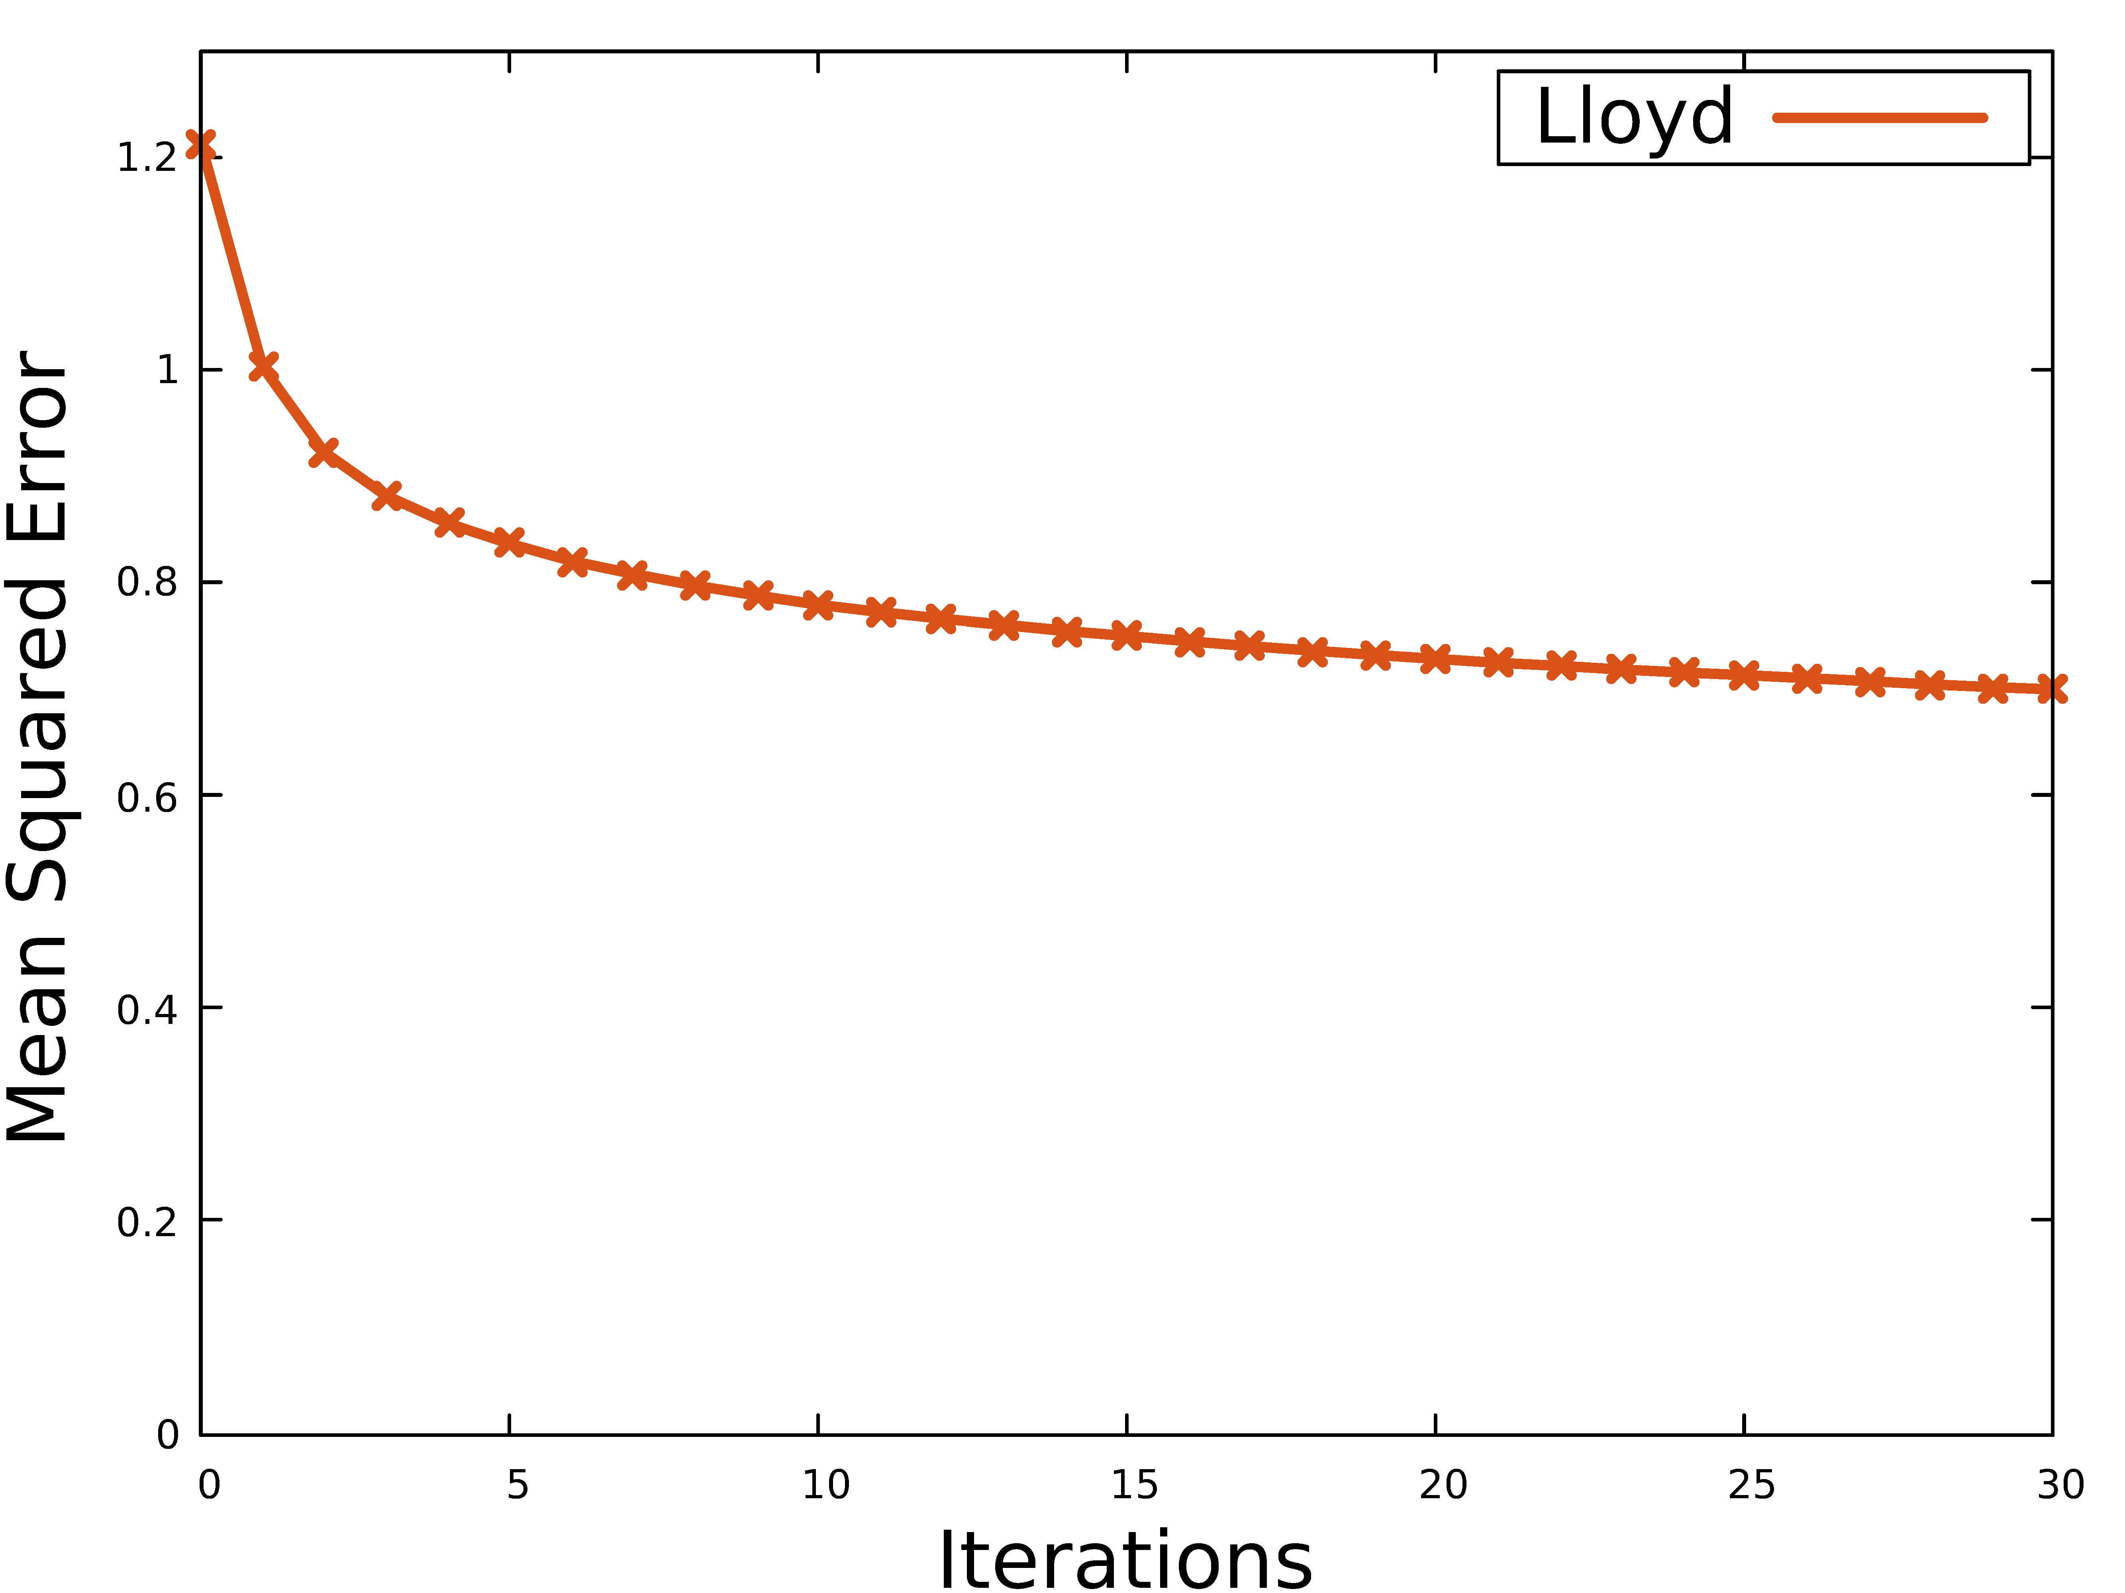
Convergence
Our Result:
Initial Distribution:
Lloyd Result:
Target:
Target:

Slide 16
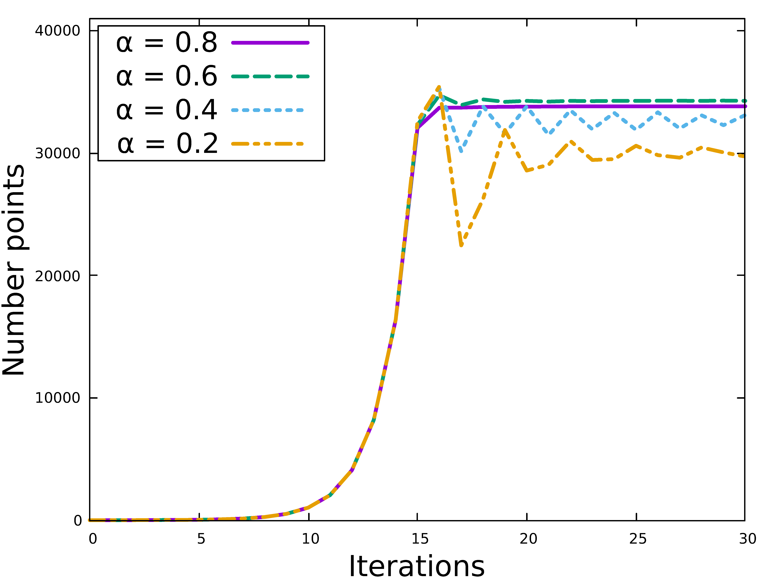
Hysteresis Parameter $α$
Low Hysteresis:
High Oscillations
Slow convergence
High quality
High Hysteresis:
Low Oscillations
Fast convergence
Lower quality

Slide 17
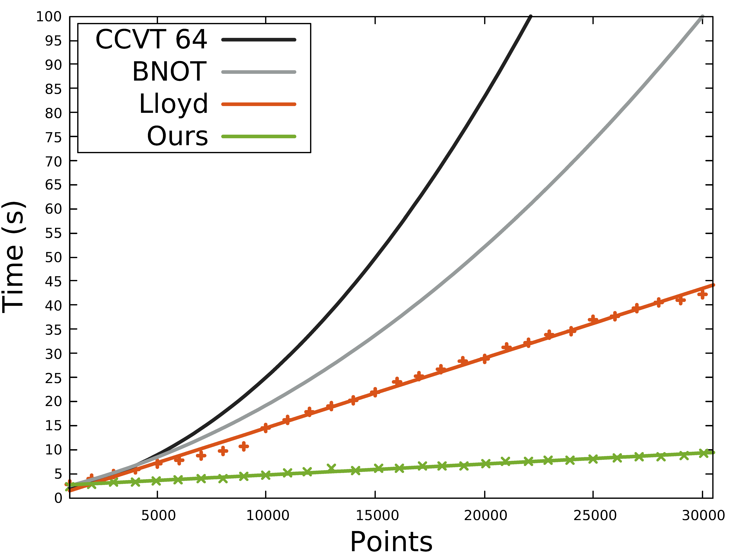
Timings
Test setup specs:
i7-4790k @ 4.0 GHz
Nvidia GTX 980 Ti

Slide 18
Evaluation of Intensity Reproduction
Reference
Q1: 1.55%
Q2: 10.92%
Q3: 29.69%
Q4: 57.83%
[de Goes et al. 2012]
Q1: 1.50%
Q2: 10.90%
Q3: 29.60%
Q4: 57.90%
Ours
Q1: 1.64%
Q2: 10.97%
Q3: 29.73%
Q4: 57.65%

Slide 19
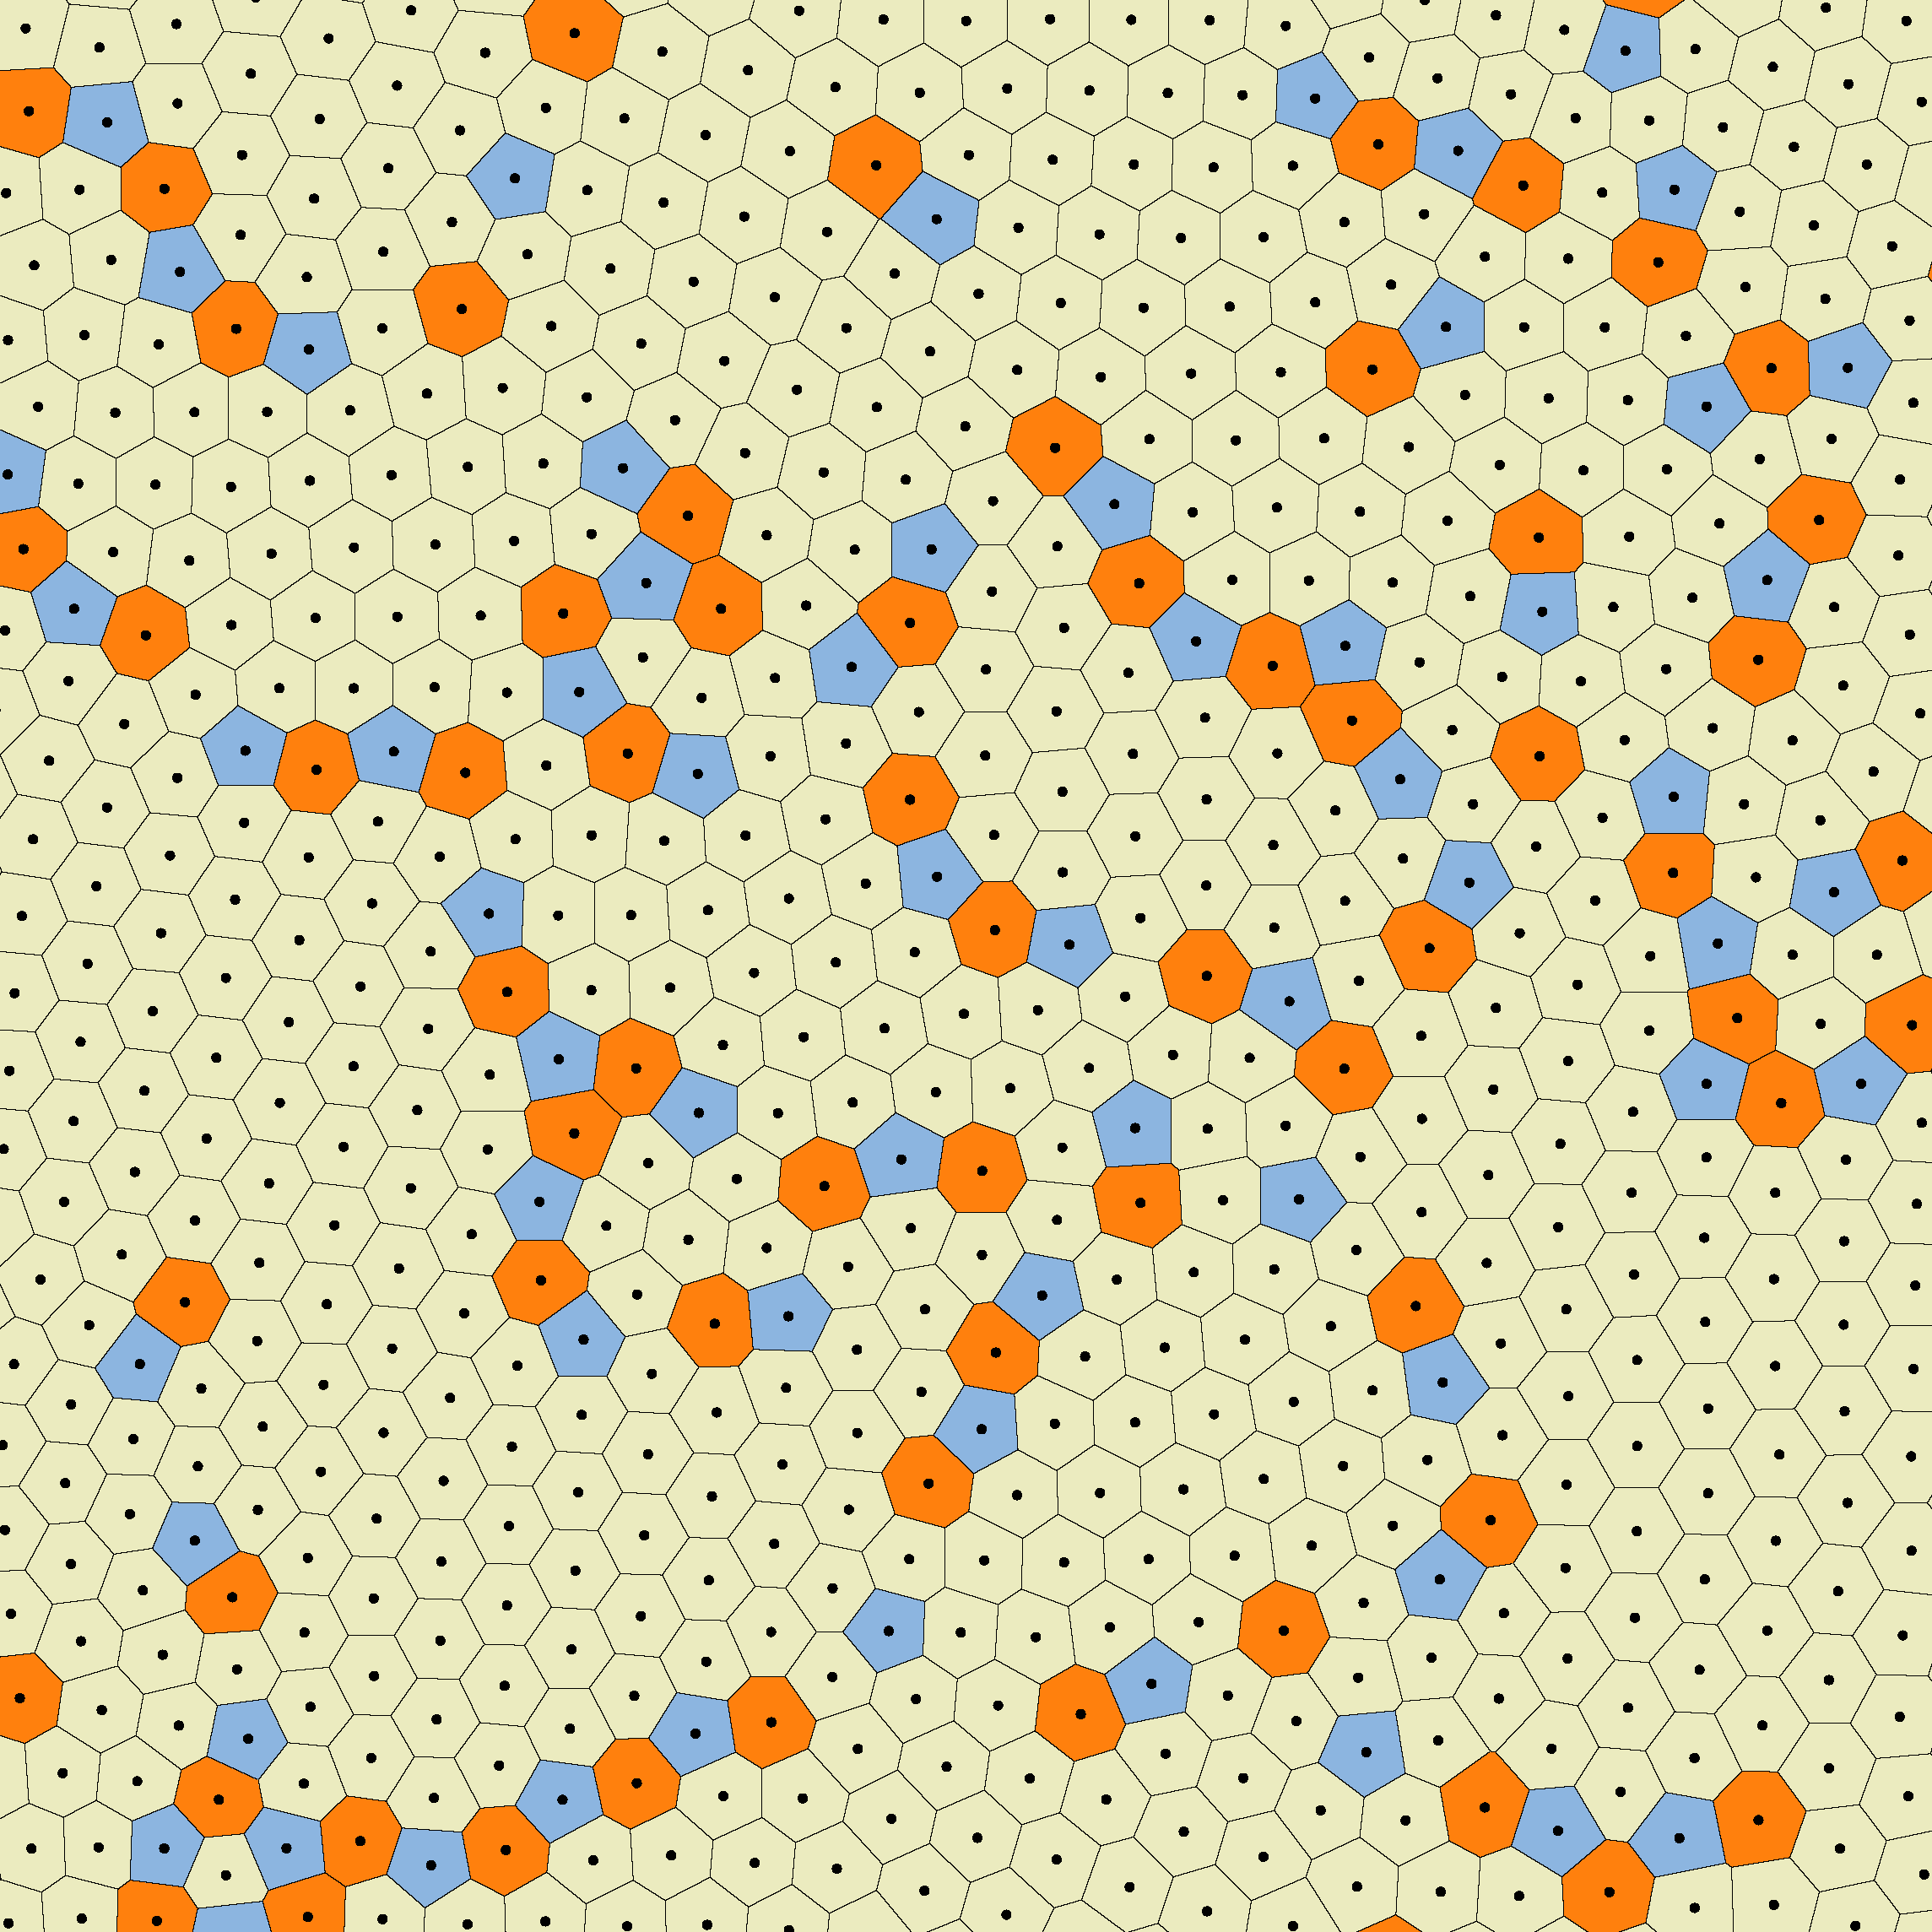
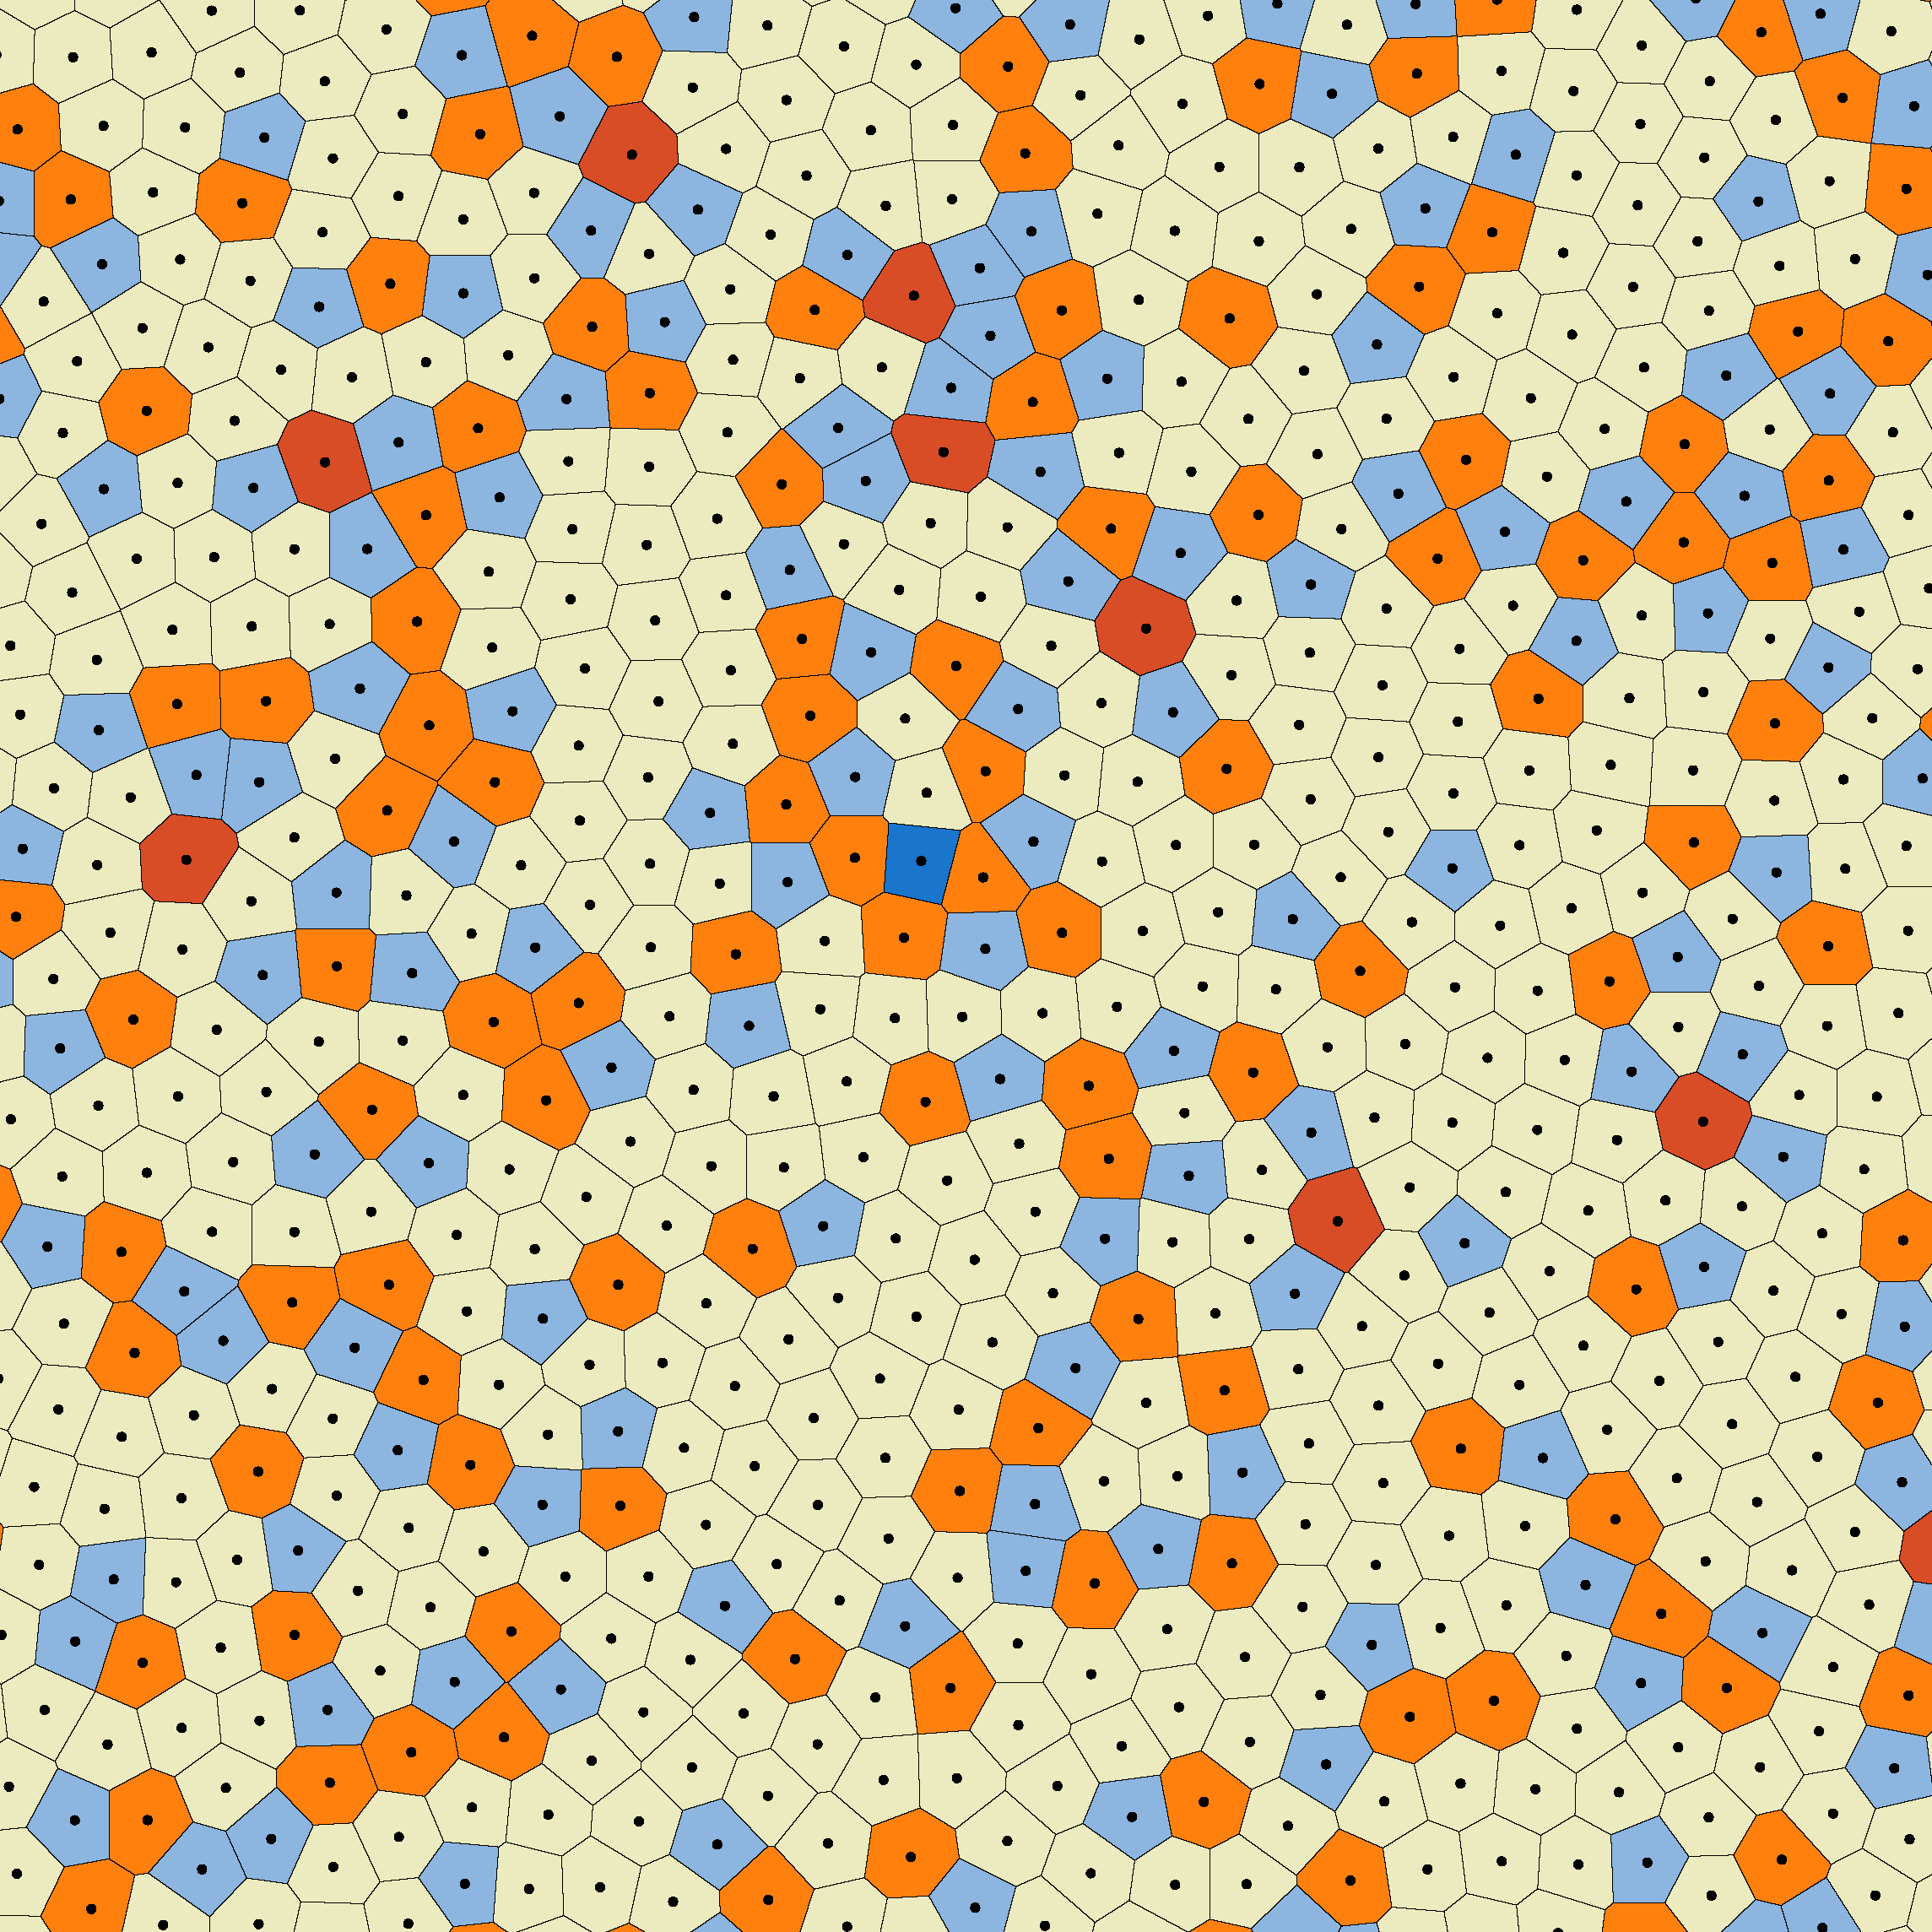
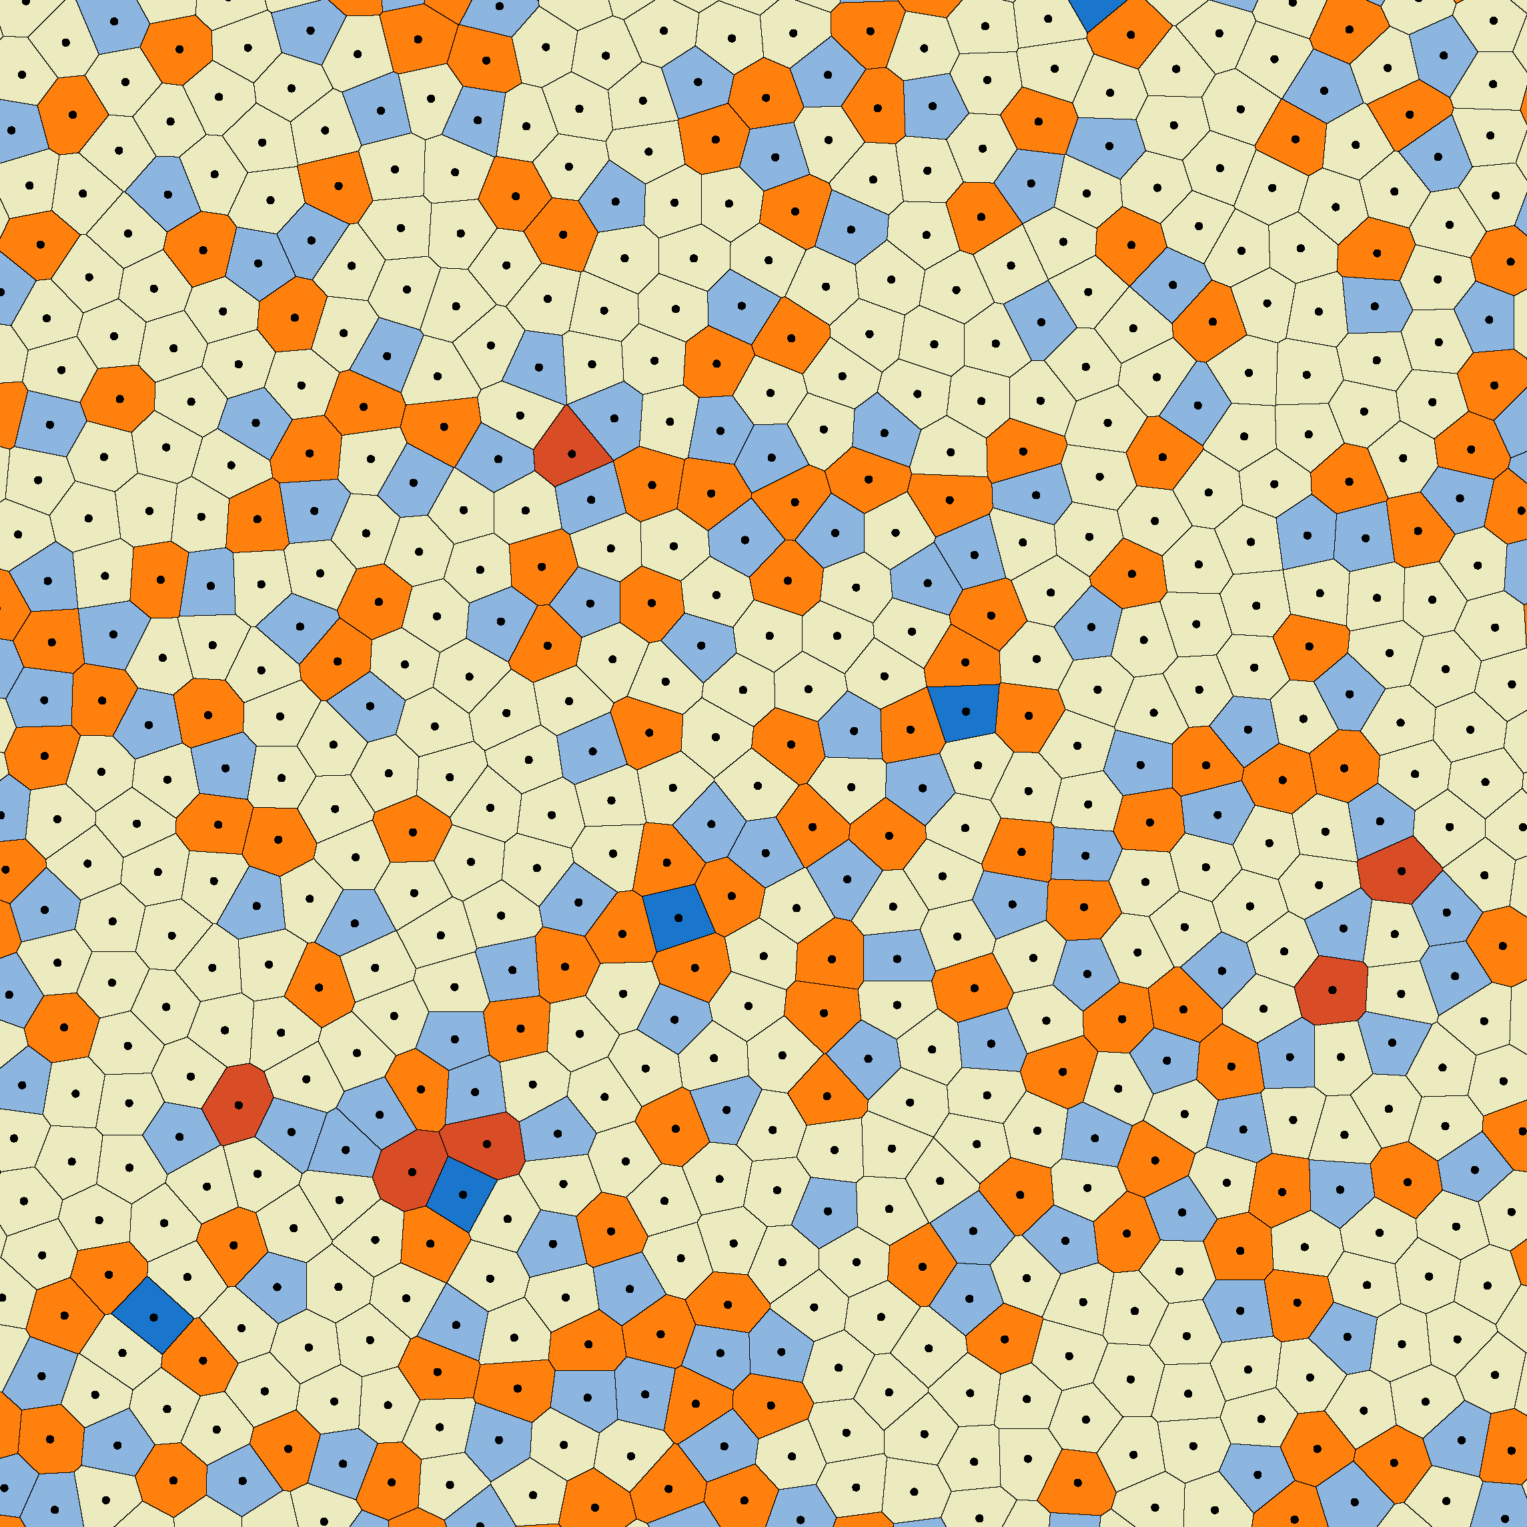
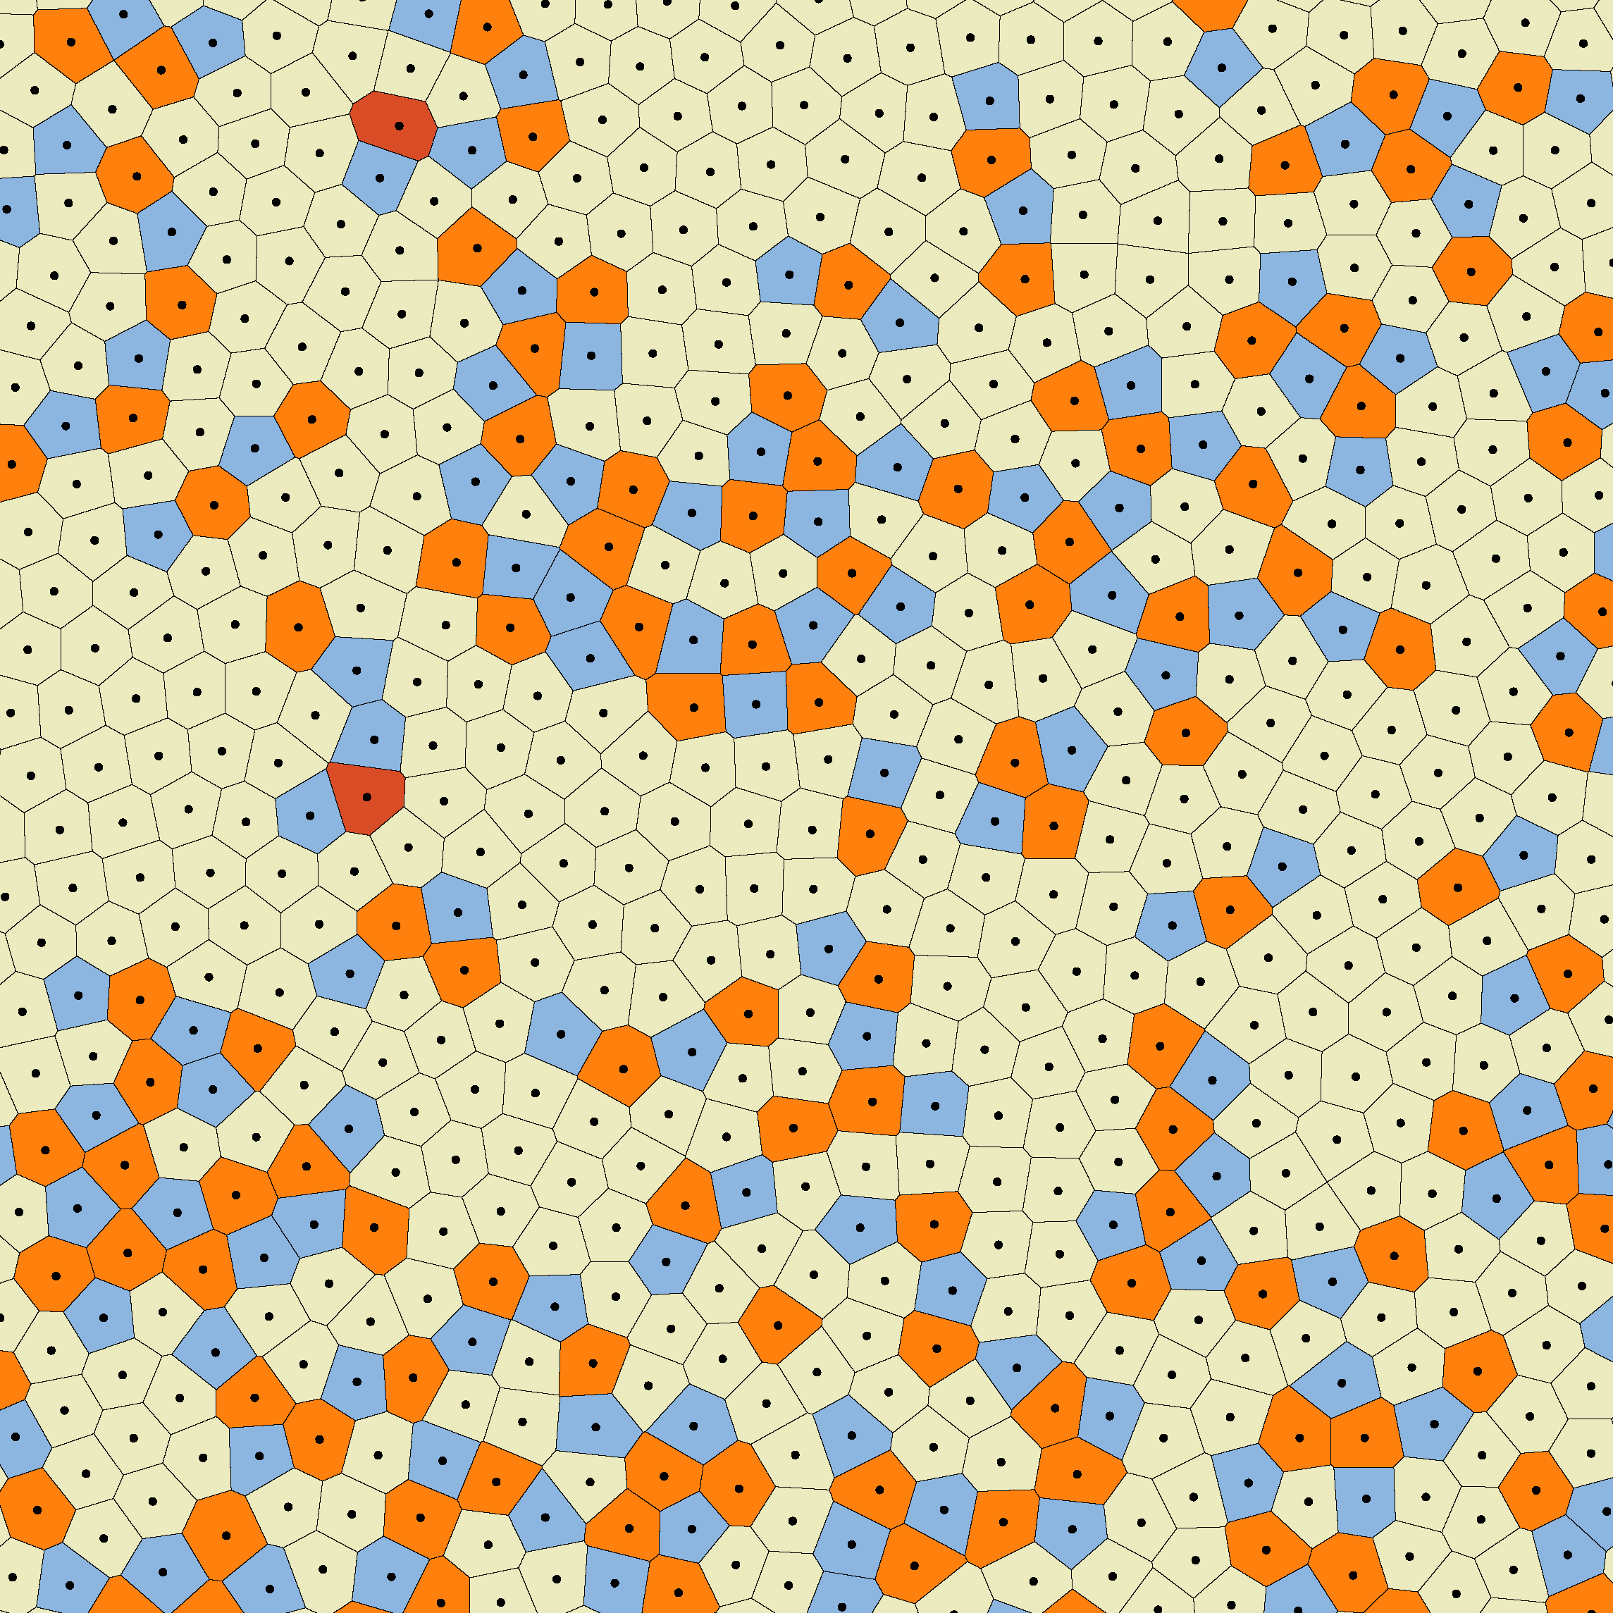
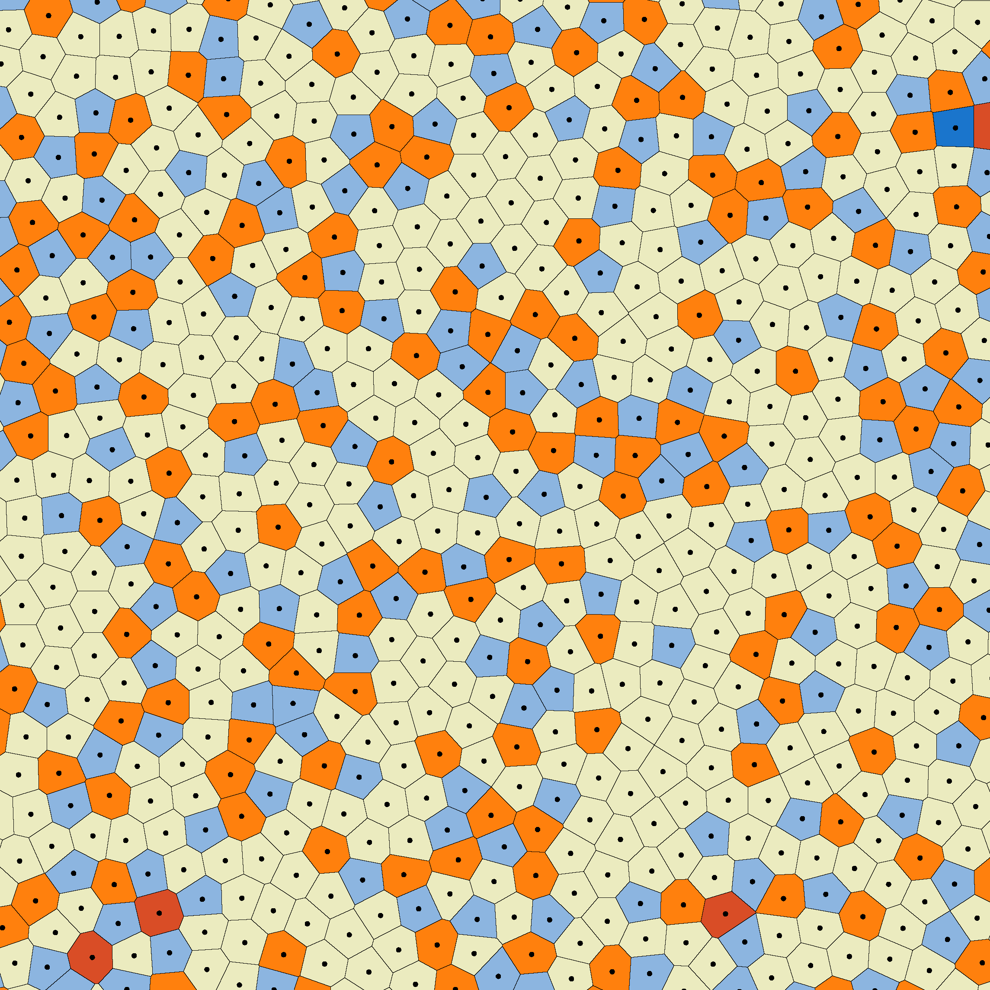
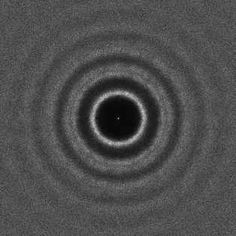
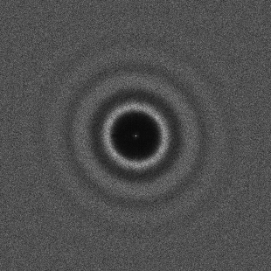
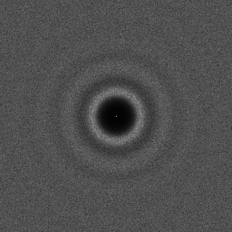
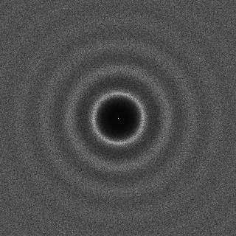
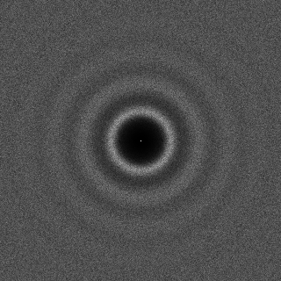
Evaluation of Spatial / Spectral Properties
Lloyd‘s Method
Ours
CCVT
Fattal
BNOT

Slide 20
Animations

Slide 22
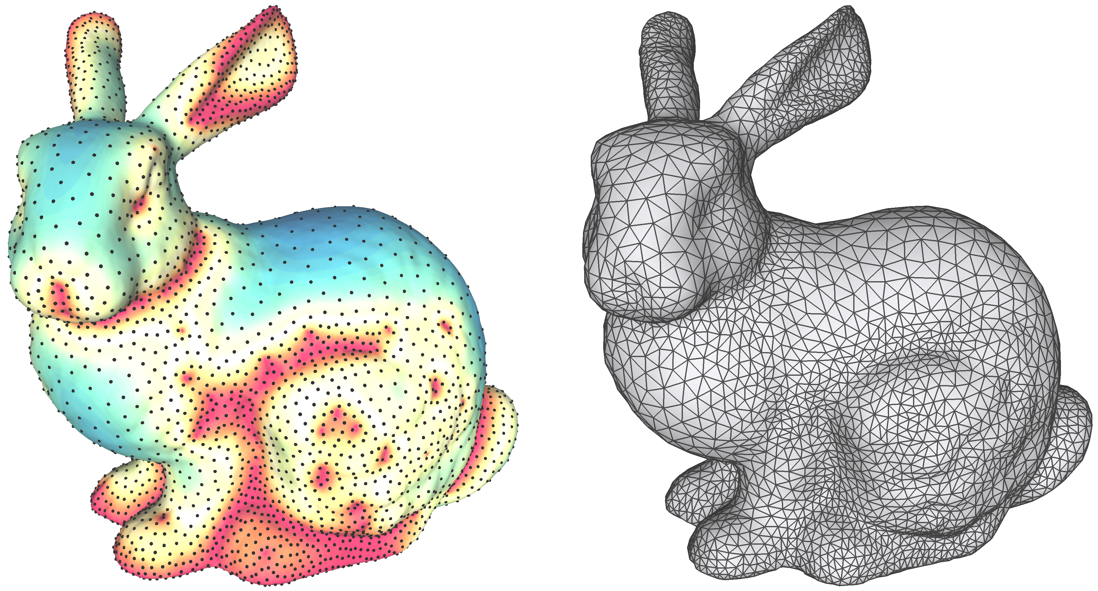

Slide 23
Conclusion
Simple yet efficient Stippling / Sampling approach.
Rapid convergence
Similar output quality to recent works
Adaptive point size / Automatic number of points.
Works well in different domains.
Animation
3D Geometry

Slide 24
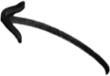
Future Work
Local error diffusion.
Split / Merge error propagation
Advanced split operations.
Number seeds based on error
Convergence prediction.
Higher dimensions.

Slide 25
Thank you!
Code available: github.com/MarcSpicker/LindeBuzoGrayStippling
Contact: marc.spicker@googlemail.com

Slide 26
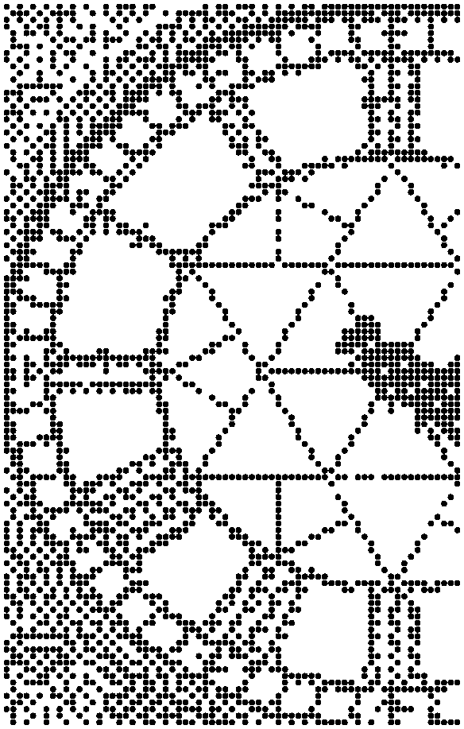
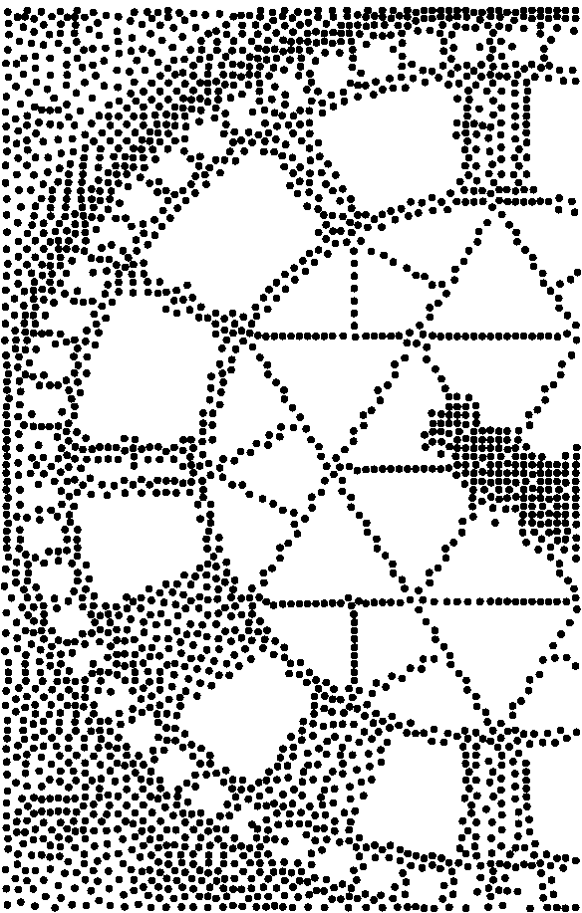
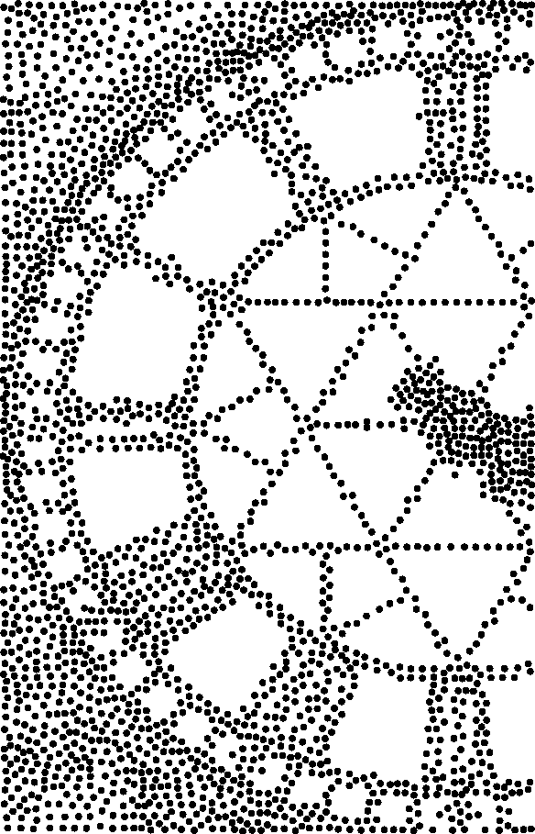
Floyd Steinberg 2D
+ 10 Lloyd Iterations
Ours

